Slide 1
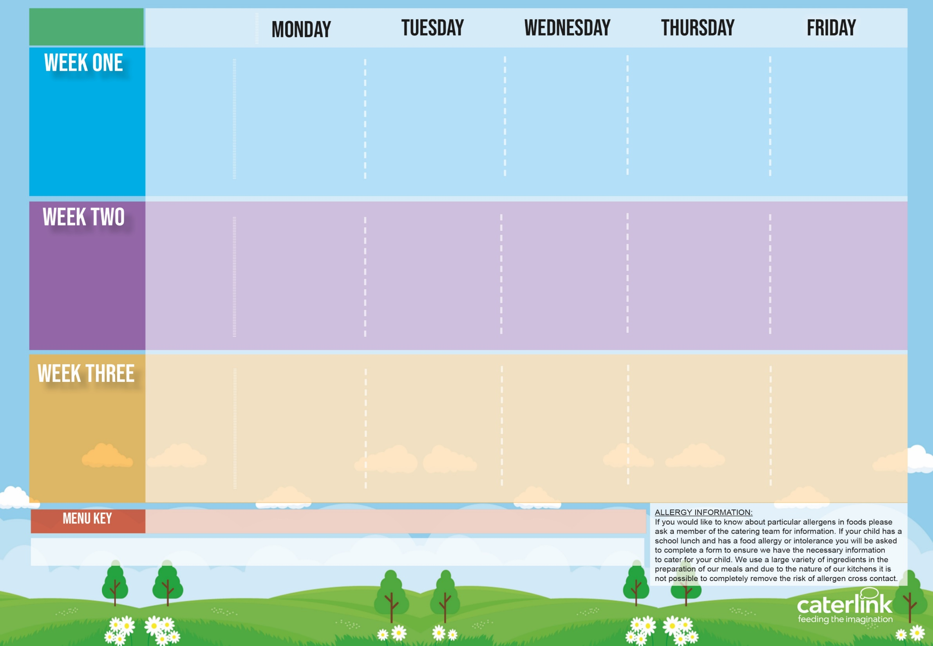
Spring Summer
2025
Macaroni & Cheese | BBQ Chicken Pizza with Salads | Roasted Pork Sausage, with Roast Potatoes & Gravy | Spaghetti Bolognaise | Salmon Fish Fingers Fishfingers with Chips & Tomato Sauce
Tomato and Vegetable Pasta | Cheese and Tomato Pizza with Salads | Roasted Quorn, Roast Potatoes, & Gravy | Vegan Bolognaise | Cheese & Bean Pasty with Chips & Tomato Sauce
Vegetables of the Day | Vegetables of the Day | Vegetables of the Day | Vegetables of the Day | Vegetables of the Day
Apple Flapjack | Summer Lemon Cake | Fruit Platter | Savoury Cheese Scone | Strawberry Jelly with Mandarins
Option One
Option Two
Vegetables
Dessert
21/04/2025
12/05/2025
09/06/2025
30/06/2025
21/07/2025
15/09/2025
06/10/2025
Option One
Option Two
Vegetables
Dessert
Lentil and Sweet Potato Curry with Rice | Pork Hot Dog with Wedges & Tomato Sauce | Roast Chicken, with Stuffing, Roast Potatoes, & Gravy | Chefs Special Chicken and Chickpea Korma with Rice | Battered Fish with Chips & Tomato Sauce
Cheese and Broccoli Pasta with Garlic Bread | Vegan Hot Dog with Wedges & Tomato Sauce | Vegetable Soya Roast, Stuffing, Roast Potatoes & Gravy | Spaghetti and Meatballs | Cheese and Tomato Quiche with Chips
Vegetables of the Day | Vegetables of the Day | Vegetables of the Day | Vegetables of the Day | Vegetables of the Day
Iced Vanilla Sponge | NEW Strawberry and Apple Crumble with Custard | Freshly Chopped Fruit Salad | Peaches and Ice Cream | Vanilla Shortbread
28/04/2025
19/05/2025
16/05/2025
07/07/2025
01/09/2025
22/09/2025
13/10/2025
Option One
Option Two
Vegetables
Dessert
Smokey Bean Burger with Potato Wedges | Chicken Pasta Bake | Roast Turkey, Stuffing, Roast Potatoes & Gravy | NEW Greek Macaroni Pastitsio with Greek Salad and Tzatziki | Breaded Fish and Chips
NEW Chefs Special Chickpea Curry with Rice | NEW Chefs Special Five Bean Jollof Rice | Vegetable Wellington, Roast Potatoes & Gravy | Spinach and Cheese Whirl with Rice, Greek Salad and Tzatziki | Mexican Bean Vegan Roll and Chips
Vegetables of the Day | Vegetables of the Day | Vegetables of the Day | Vegetables of the Day | Vegetables of the Day
Pear & Cocoa Upside Down Cake | Cheese and Crackers | Fruit Medley | Jam and Coconut Sponge | Oaty Cookie
05/05/2025
02/06/2025
23/06/2025
14/07/2025
08/09/2025
29/09/2025
20/10/2025
Added Plant Protein
Wholemeal
Vegan
Chef’s Special
Available Daily: - Freshly cooked jacket potatoes with a choice of fillings - Bread freshly baked on site daily- Daily salad selection – Fresh Fruit and Yoghurt

Slide 2
Spring Summer
2025
Option One
Option Two
Vegetables
Dessert
V302 Tomato & Vegetable Pasta Sauce | C91 BBQ Chicken Pizza with SD92 SB8 SD126 Salads | P3 Pork Sausage, SD82 Roast Potatoes & SD118 Gravy | SD8 Spaghetti B48 Bolognaise | F1 Salmon Fish Fingers F6 Fishfingers with SD5 Chips & SD14 Tomato Sauce
V11 Macaroni Cheese Toppings PK3 PK4 V85 V216 Pasta: SD8 SD11 SD9 | V231 Cheese and Tomato Pizza with SD92 SB8 SD126 Salads | V204 Roast Quorn, SD40 Stuffing, SD82 Roast Potatoes, & SD118 Gravy | V233 SD11 Vegan Bolognaise | V191 Cheese & Bean Pasty With SD5 Chips & SD14 Tomato Sauce
Vegetables of the Day | Vegetables of the Day | Vegetables of the Day | Vegetables of the Day | Vegetables of the Day
D171 Apple Flapjack | D168 Summer Lemon Cake | D225 Fruit Platter | D254 Savoury Cheese Scone | D235 Strawberry Jelly with Mandarins
21/04/2025
12/05/2025
09/06/2025
30/06/2025
21/07/2025
15/09/2025
06/10/2025
Option One
Option Two
Vegetables
Dessert
V108 Lentil and Sweet Potato Curry with SD84 Rice | P3 SD187 Pork Hot Dog with SD6 Wedges & SD14 Tomato Sauce | C5 Roast Chicken Thigh, SD40 Stuffing, SD82 Roast Potatoes, & SD118 Gravy | NEW C111 Chef Special Chicken and Chickpea Korma with SD84 Rice | F3 Battered Fish with SD5 Chips & SD14 Tomato Sauce
V304 Cheese and Broccoli Pasta with SD50 Garlic Bread | V244 SD187 Vegan Hot Dog with SD6 Wedges & SD14 Tomato Sauce | V13 Lentil and Vegetable Soya Roast with SD82 Roast Potatoes & SD118 Gravy | SD8 Spaghetti and V237 V225 Meatballs | V113 Cheese and Tomato Quiche with SD5 Chips
Vegetables of the Day | Vegetables of the Day | Vegetables of the Day | Vegetables of the Day | Vegetables of the Day
D177 Iced Vanilla Sponge | NEW D259 Strawberry and Apple Crumble with Custard | D223 Freshly Chopped Fruit Salad | D166 Peaches and D13 Ice Cream | D57 Vanilla Shortbread
28/04/2025
12/05/2025
09/06/2025
30/06/2025
21/07/2025
15/09/2025
06/10/2025
Option One
Option Two
Vegetables
Dessert
V323 SD17 Bean Burger with SD6 Potato Wedges | C101 Chicken Pasta Bake | T1 Roast Turkey, SD40 Stuffing, SD82 Roast Potatoes & SD118 Gravy | NEW GR6 Greek Macaroni Pastitsio with GR4 Greek Salad and GR3 Tzatziki | F7 Breaded Fish and SD5 Chips
NEW V321 Chefs Special Chickpea Curry with SD84 Rice | NEW V322 Chefs Special Five Bean Jollof Rice | V232 Veg Wellington, SD82 Roast Potatoes & SD118 Gravy | GR2 Spinach and Cheese Whirl with SD84 Rice, GR4 Greek Salad and GR3 Tzatziki | V161 Mexican Bean Vegan Roll SD5 Chips
Vegetables of the Day | Vegetables of the Day | Vegetables of the Day | Vegetables of the Day | Vegetables of the Day
D207 Pear & Cocoa Upside Down Cake | D56 Cheese and Crackers | D224 Fruit Medley | D233 Jam and Coconut Sponge | D85 Oaty Cookie
05/05/2025
02/06/2025
23/06/2025
14/07/2025
08/09/2025
29/09/2025
20/10/2025

